Slide 1
Final Project Report – “Roadmap for development of future GUIDs in the 5100 Series”
Presentation by
SAI Pakistan

Slide 2
Sequence of Presentation
Project Background
Project Team
Roadmap Document -- Objectives
Project timeline and progress
Overview of the Final Roadmap Document
Additional Submissions
Proposals before WGITA

Slide 3
Abbreviations
AI | Artificial Intelligence
ACFE | Association of Certified Fraud Examiners
EUROSAI | European Organization of Supreme Audit Institutions
FIPP | Forum for INTOSAI Professional Pronouncements
GIS | Geographic Information Systems
GUID | INTOSAI Guidance
HR | Human Resource
IFPP | INTOSAI Framework of Professional Pronouncements
INTOSAI | International Organization of Supreme Audit Institutions
IoT | Internet of Things
ISSAI | International Standard of Supreme Audit Institutions
IT | Information Technology
KPI | Key Performance Indicators
KSC | Knowledge Sharing Committee
SAI | Supreme Audit Institution
SDI | Spatial Data Infrastructure
SDP | Strategic Development Plan
WGITA | Working Group on Information Technology Audit

Slide 4
1. Project Background
During 25th WGITA meeting at Brasilia, Brazil, subject project was approved as part of WGITA Workplan 2017-19
Initially title of project was,
“Development of Roadmap for future ISSAIs in the 5300 Series”

Slide 5
1. Project Background …Contd.
In December 2016, the INTOSAI Framework of Professional Pronouncements (IFPP) was approved and Strategic development plan (2017-19) for IFPP initiated.
The Series (that dealt with the subject of IT auditing) was shifted from ISSAIs to GUIDs or Guidance.
New number series allocated to IT Auditing was under 5100

Slide 6
1. Project Background …Contd.
Accordingly the project title was modified to its current form:
“Roadmap for development of future GUIDs in the 5100 Series”

Slide 7
2. Project team
Team Lead: SAI Pakistan
Team members:
SAI Brazil
SAI China
SAI India
SAI Japan
SAI Korea
SAI Poland
SAI USA

Slide 8
3. Roadmap Document -- Objectives
To act as reference document for development of future GUIDs in the domain of IT Auditing.
It envisages development of future GUIDs in a logical manner.
It identifies significant subjects for development of future GUIDs.
The target group for the roadmap document are KSC and PSC of INTOSAI.

Slide 9
4. Project timeline and progress
Activity | Time frame -- Dates
Draft Project Initiation Document (PID) was prepared | August 2016
Final PID after Input from team members submitted to WGITA Chair | October 2016
PID Approved | 23rd Oct. 2016
Draft Project Plan prepared | December 2016
Final Project Plan after input from team members prepared & submitted to WGITA Chair | March 2017
Project Plan Approved | May 2017

Slide 10
4. Project timeline and progress…Contd.
Activity | Time frame – Dates
Data acquisition and review stages: Inputs received from SAI Team members Data Analysis done | June to Dec 2017
Initial Draft Roadmap prepared | February, 2018
Initial Draft Roadmap circulated amongst Team members and feed back received | March, 2018
Initial Draft presented at 27th WGITA meeting Sydney | April, 2018

Slide 11
4. Project timeline and progress…Contd.
Activity | Time frame – Dates
Draft Modified: No. of proposed GUIDs titles reduced from 15 to 08 | June 2018
Draft revised and prepared based on inputs from team members | June to November 2018
Draft circulated amongst team members for final suggestions and scrutiny | December 2018
Input on the Draft received from team members and final report prepared | December 2018 & January 2019
Final report submitted to WGITA Chair for approval | 02 Feb- 2019

Slide 12
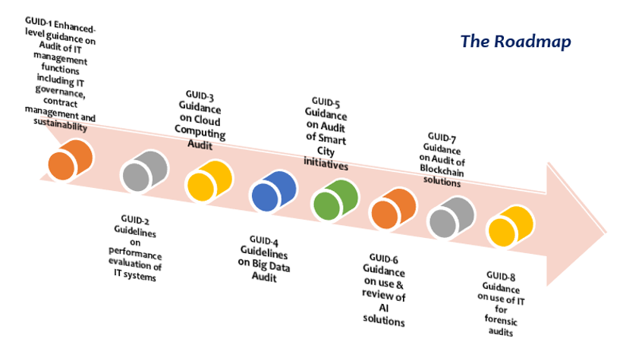
5. Overview of the Roadmap document

Slide 13
5. Overview -- Roadmap Document
The Roadmap document outlines its objectives and intended purpose.
It highlights the need for development of a roadmap.
It highlights how the globalized IT environment is effecting Auditing techniques and practices.
The “structure” for development of the roadmap is defined (fig on next slide)
It is developed as a “live document” to be reviewed periodically.

Slide 14
Structure of the Roadmap
1. Analyzing the IT Landscape
Highlighting Specific/New IT Areas/Interventions/Solutions
Proposing Suitable GUID to cover audit requirement for a specific IT Area/Intervention/Solution

Slide 15
5. …continued
First the “Broad Contours of todays IT landscape” have been defined.
Co-relation between different IT areas highlighted.
Then a “linkage” is developed between the IT landscape and IT Audit requirements.

Slide 16
Logical Linkage Between an IT Area and Audit Requirements
Specific IT Tools/Solutions
An IT Area
Audit Requirements
Analysis & Usage of the IT Area's manifestations

Slide 17
5 … continued
08 Subjects proposed for the development of future GUIDs’ in IT Auditing.
Lastly additional submissions for future WGITA work have been added.

Slide 18
5.1 Proposed subjects for future GUIDs

Slide 19
Enhanced-Level Guidance On Audit Of IT Management Functions Including IT Governance, Contract Management And Sustainability – GUID 01
The GUID embodies a more in-depth and dynamic review of IT management functions
More enhanced level checklist and guiding techniques
Main subjects would be IT governance, IT contract management and IS sustainability requirements

Slide 20
Enhanced-Level Guidance On Audit Of IT Management Functions Including IT Governance, Contract Management And Sustainability – GUID 01 …Contd.
The GUID may also be viewed from a long term perspective.
As technological solutions evolve, demand for more current IT techniques in subject areas would lead to changing audit assurance requirements
Hence this GUID after its initial version could be an apt case for future revisions as well.

Slide 21
Guidelines on Performance Evaluation Of IT Systems – GUID 02
It would enable the auditor to formulate basic KPIs to gauge the overall performance of an Information System (IS)
It would enable Quantitative analysis on the performance of an IS
It would cover all IS aspects from design, to implementation, HR, economy and outcomes etc.
It would facilitate the Performance Audit exercise

Slide 22
Guidance on Cloud Computing Audit – GUID 03
It would deal with the specific subject of Cloud Computing, its various forms and models.
Guide the auditor to review the cloud computing solutions along parameters such as, reliability, sustainability, security etc.
Would address each model of cloud computing covering the risks and control measures related to each model.

Slide 23
Guidelines on Big Data Audit – GUID 04
It would deal exclusively with the subject of Big Data audit
It would highlight the different features of Big Data
It would provide guidance on how the auditor may perform Big Data analytics
It would provide guidance on how Big Data evidence can be correlated for audit reports

Slide 24
Guidance on Audit Of Smart City Initiatives – GUID 05
Smart city initiatives are the emerging urban reality
Smart city initiatives are inherently cross-functional and IT driven
SDI, GIS applications and various IoT products are common segments of a smart city solution.
The GUID would address the broad topic of audit of smart-cities, define its contours and
provide guidance on how to go about auditing a smart-city project.

Slide 25
Guidance on The Use And Review Of Artificial Intelligence Solutions – GUID 06
There are two aspects of AI that concern the work of SAIs:
Use of AI tools to augment, enhance and update the auditing activities
Review and assessment of AI interventions adapted by auditee
AI Solutions likely to be outsourced to multiple third parties

Slide 26
Guidance on The Use And Review Of Artificial Intelligence Solutions – GUID 06 …Contd.
Some AI risks include
risk of human bias and human error in the embedded / AI technology,
risk of inadequate testing,
risk of not being able to manage/control the AI product
and the risk of harm (financial and non-financial) associated with AI implementation.

Slide 27
Guidance on The Use And Review Of Artificial Intelligence Solutions – GUID 06 …Contd.
Use of AI based techniques such as machine learning, deep learning etc. can enhance audit capacity
The guide is proposed as a comprehensive document to assist SAIs in both
the use and
review of AI solutions.

Slide 28
Guidance on Audit Of Blockchain Solutions – GUID 07
Essentially Blockchain is a distributed database solution that maintains a continuously growing list of data records that are confirmed by the nodes participating in it.
All the nodes in the blockchain are anonymous
Each transaction data is first shared amongst all nodes.
Each node verifies whether the new proposed block is valid, i.e was not present before etc.

Slide 29
Guidance on Audit Of Blockchain Solutions – GUID 07… Contd.
AI has wide scope for application: cryptocurrency, smart contracts, property licensing, voting etc.
From a long term perspective this GUID would facilitate the SAI auditor to effectively review a blockchain implementation
Considering the specialized area of blockchain the current subject is proposed as a GUID

Slide 30
Guidance on use of IT for Forensic Audits – GUID 08
The risk of malpractices has increased –
IT transaction challenges have added to the traditional set of challenges related to financial transparency and accountability
ACFE estimates that occupational fraud losses cost organizations $994 billion annually (ACFE ,2008)
Forensic audits are gaining significance & IT audit techniques form a key element of a forensic audit exercise.

Slide 31
Guidance on use of IT for Forensic Audits – GUID 08…Contd.
From a long term perspective forensic audit comprising of significant IT areas are expected to materialize.
The GUID is proposed to equip the SAI auditor to be able to aptly use IT techniques for specific perspective of forensic audit reports.

Slide 32
6.Additional Submissions
1. Formation of IT Materiality:
Q: how to quantify/grade the lapses in the IT system and translate them into overall assessment of the IT solution in place.
A: a document, that may help auditors to categorize and rate different controls parameters of an IT solution
A: an IT grading matrix could be established and IT materiality benchmark defined for the IT system being reviewed

Slide 33
6.Additional Submissions ….Contd.
2. Another joint IT Audit exercise amongst SAIs may be organized.
3. The IT Audit Handbook could be used in its active form.
It would give the possibility to add new areas or topics as plug-ins, and then to work with them in real life audits.
The best plug-ins could be upgraded to the core content of the Handbook.

Slide 34
7. Proposals before WGITA
To Take note of the final report on the WGITA Project, “ Roadmap for development of future GUIDs in the 5100 Series”.
To approve the Final Report of the project.

Slide 35
Thank You!

